Slide 1
Algorithm of semantic segmentation of tomographic images using DNN
Sc. supervisor: Vladimir Berikov
Ms. student: Sergey Pnev

Slide 2
Goals
Good dataset of CT scans of the brain with the effects of ischemic stroke
NN model for accurate segmentation

Slide 3
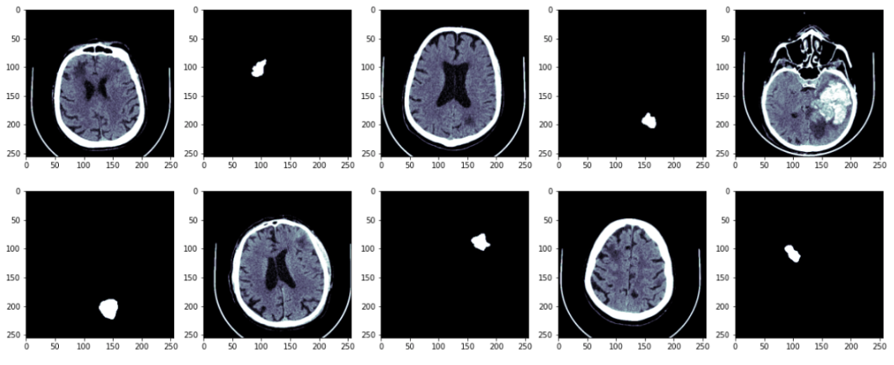
Data
We have 25 CT-images of brain with consequences of ischemic stroke

Slide 4
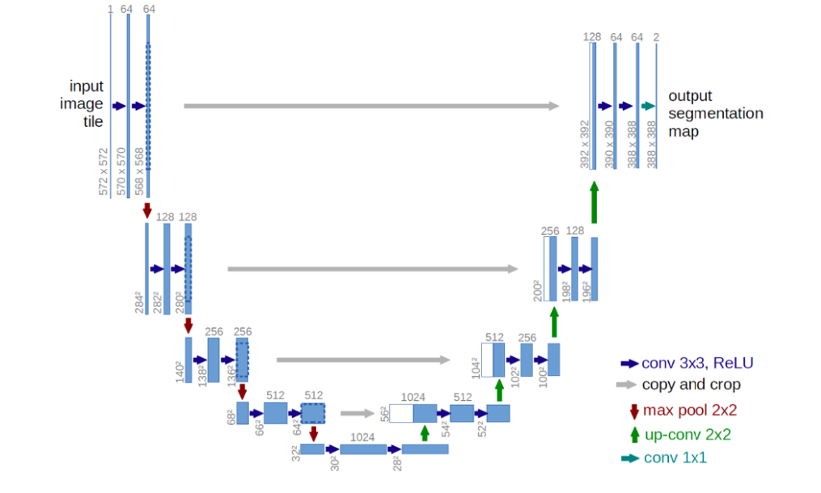
U-net

Slide 5
Chanel attention

Slide 6
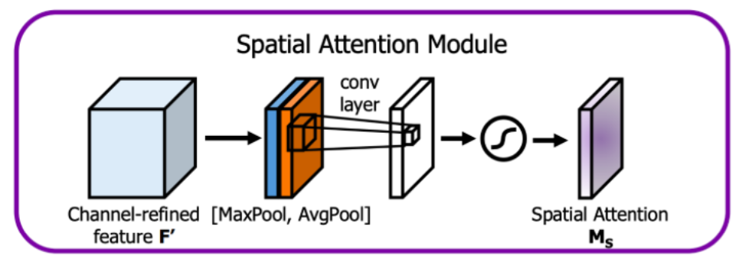
Spatial attention

Slide 7
CBAM

Slide 8
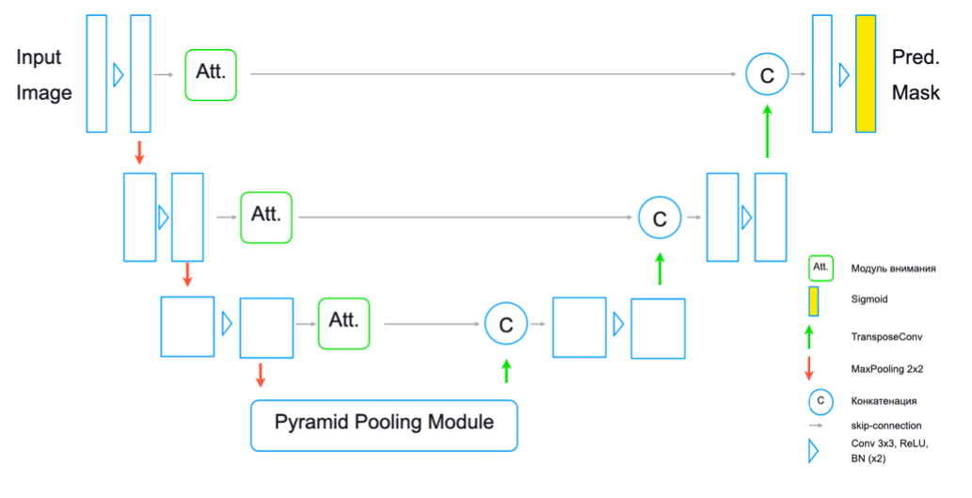
Proposed architecture

Slide 9
Results at the moment
Architecture | Config | BCE + (1 - Dice)
UNet | 3-1-3 | 0,77
UNet + att. module on the encoding stage | 3-1-3 | 0,82
UNet + att. module on the encoding stage + parallel att.module at the decoding stage | 3-1-3 | 0,68
UNet + att. module on the encoding stage + sequence att.module at the decoding stage | 3-1-3 | 0,69
UNet | 4-1-4 | 0,71
UNet + att. module the encoding stage | 4-1-4 | 0,72

Slide 10
Plan
2nd semester:
1. MRI dataset from ISLES competition
2. Increase the dataset with CT-images
3rd semester:
3. Experiments with the model and attention mechanisms
4th semester:
4. Master thesis

Slide 11
Thank you!

