Slide 1
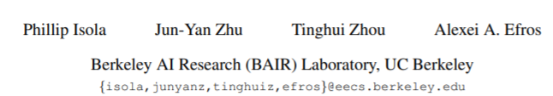
Image-to-Image Translation with Conditional Adversarial Networks
Review by Kochanov Maxim

Slide 2
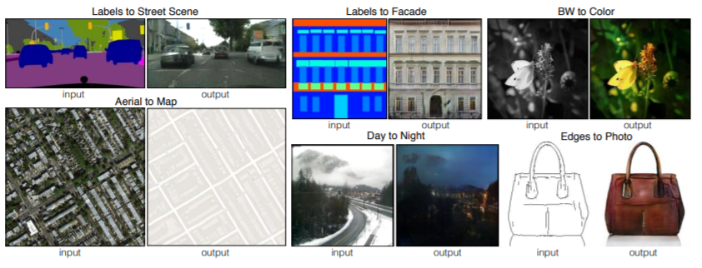
Abstract

Slide 3
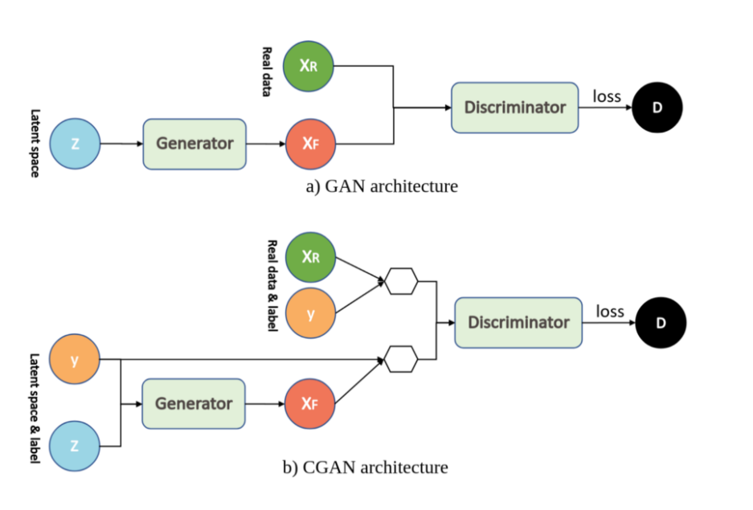
GAN vs CGAN
The intuition behind the conditional information, y, is that by adding additional information both the generator G and the discriminator D learn to operate in certain modes.

Slide 4
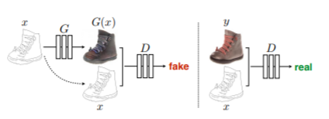
CGAN Example

Slide 5




Objective
(1)
G* =
(2)
(3)
(4)
(5)

Slide 6
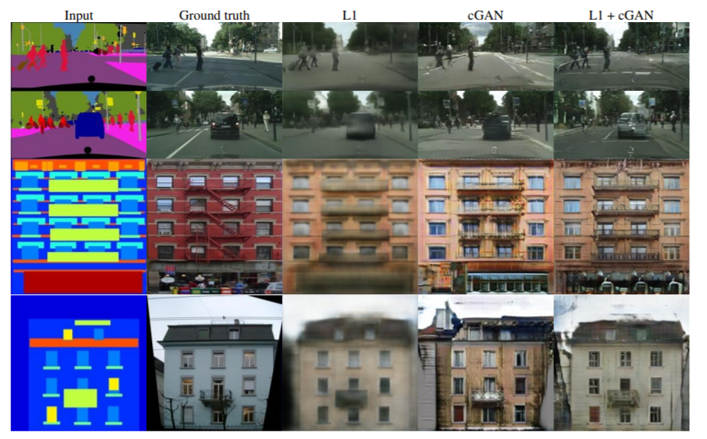
Different losses induce different quality of results. Each column shows results trained under a different loss.

Slide 7
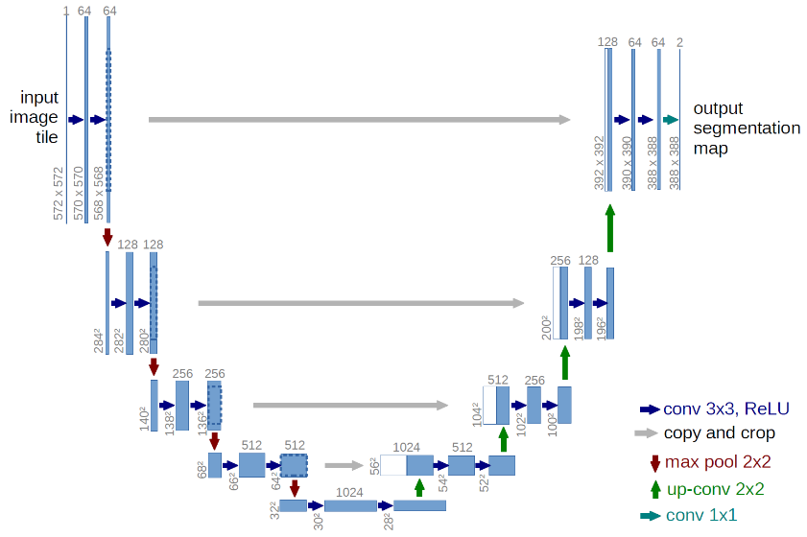
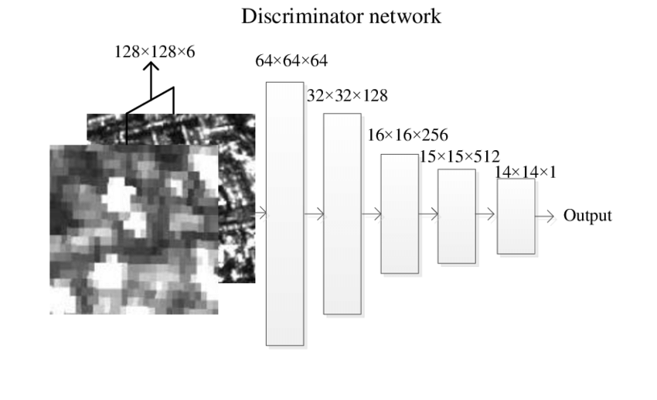
Architecture
for generator authors use the U-Net
for discriminator authors use PatchGAN discriminator

Slide 8
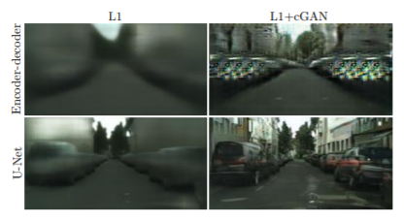
Adding skip connections to an encoder-decoder to create a “U-Net” results in much higher quality results.

Slide 9

Realization pix2pix
https://github.com/junyanz/pytorch-CycleGAN-and-pix2pix

Slide 10
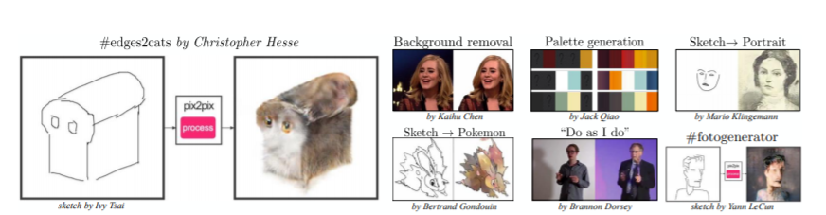
Some examples of pix2pix

Slide 11
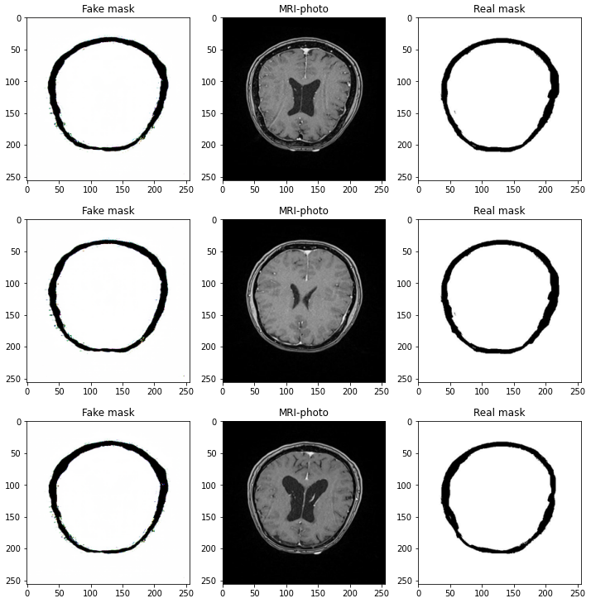
My results
Model = pix2pix
Train size = 810
Epochs = 58
Batch size = 1

Slide 12
Thank for your attention!
I`m ready to answer your questions ;)

