Slide 1
Application of Artificial Intelligence in Predicting Dengue Outbreak in the Philippines
Virgilio D. Espina
Big Data Analytics and Artificial Intelligence
Department of Mathematics and Mechanics
Novosibirsk State University
Alexey Kolesnikov, PhD
Department of Cartography and Geoinformatics
Siberian State University of Geosystem and Technologies

Slide 2
What is Dengue (WHO)
A mosquito-borne viral infection that is common in warm, tropical climates
Infection is caused by any one of four closely related dengue viruses (called serotypes)
lead to wide spectrum of symptoms
extremely mild (unnoticable)
may require medical intervention and hospitalization
can be fatal (severe cases)
No treatment for the infection but symptoms can be managed
Top 10 diseases for 2019
Fastest spreading, epidemic-prone infectious disease

Slide 3
Who Spreads Dengue: Aedes aegypti/albopictus
Virus is spread through the bite of female mosquito
Becomes infected when it takes blood of an infected person with the virus
Typically lay eggs near standing water in containers that hold water
buckets
bowls
animal dishes
flower pots and vases
unused tires
Prefer to bite people
live both indoors/outdoors near people
Daytime feeder
Early morning
Evening before dusk
They also spread Zika and Chikununya virues

Slide 4
Dengue Status in the Philippines
Notes:
Case fatality Rate Target (CFR) = 0.1%

Slide 5
Dengue Status: Central Visayas, Philippines
Cebu City: Increased in first two months of 2020 with 5,933 infection (Outbreak News Today, March 6, 2020)
Cebu City: 8,724 cases with atleast 31 dengue deaths
case fatality rate 0.3% > 0.1 % National Dengue Program Goal (Cebu Daily News, July 8, 2020)
Region 6: 3,675 cases from January 2020 to October 2020 (ProMED, International Society for Infectious Diseases, November 21, 2020)
Note: Established seasonal and cyclical epidemic patterns, with large outbreaks occuring at 2-3 years intervals. (Chapter 1, General Considerations, WHO)
Department of Health: The Department of Health is the executive department of the Government of the Philippines responsible for ensuring access to basic public health services by all Filipinos through the provision of quality health care and the regulation of all health services and products.

Slide 6
Philippine Map: Central Visayas

Slide 7
Reserach Objective
To predict dengue outbreak in the Philippines at barangay level
To analyse the spatial-temporal pattern of dengue fever epidemics in region 6 and region 7
Compare the main influencing factors affecting the spatial disparities of dengue outbreak in the two regions.

Slide 8
Reserach Objective
To analyse the spatial-temporal pattern of dengue fever epidemics in region 6 and region 7
Moran’s I
n - number of grids in the study area
x_{i} and x_{j} - dengue occurence in grids i and j
w_{ij} - matrix of spatial weights
Notes:
Moran’s I is generally tested by the Z-score/ P-value, and the value varies from − 1 to 1. A higher
Moran’s I (larger Z-score and proper P-value) indicates greater similarity among attributes between
adjacent spatial grids [32], which reveals that the DF epidemic is clustered in the region, whereas a low
negative value indicates dissimilarity between adjacent grids and shows that the DF epidemic is discretely distributed in the region

Slide 9
Reserach Objective
Compare the main influencing factors affecting the spatial disparities of dengue outbreak in the two regions.
General Additive Model (GAM)
Geographically Weighted Regression (GWR)
Geographically Weighted Machine Learning (GWML)
Geographically Weighted Artificial Neural Network (GWANN)

Slide 10
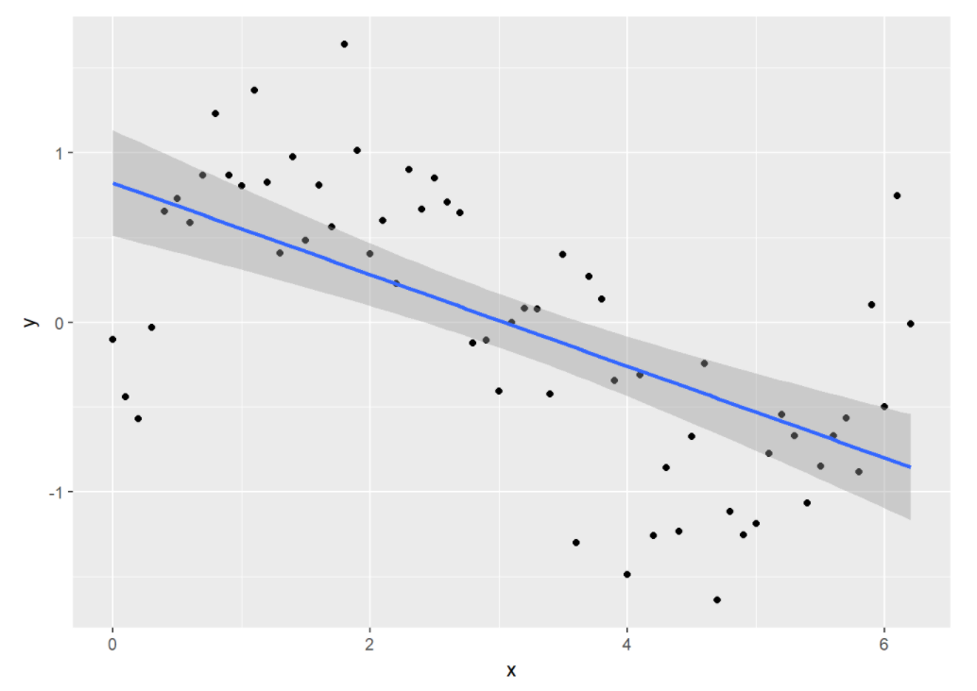
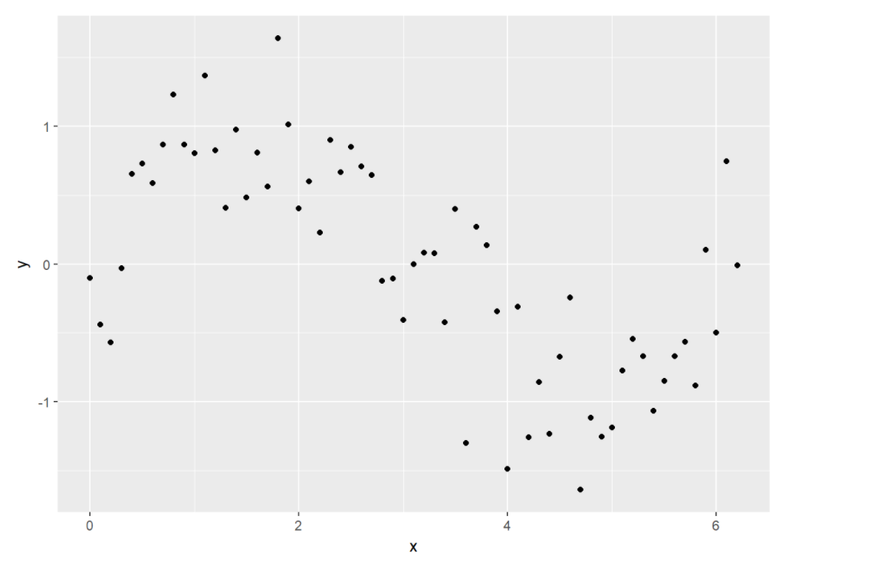
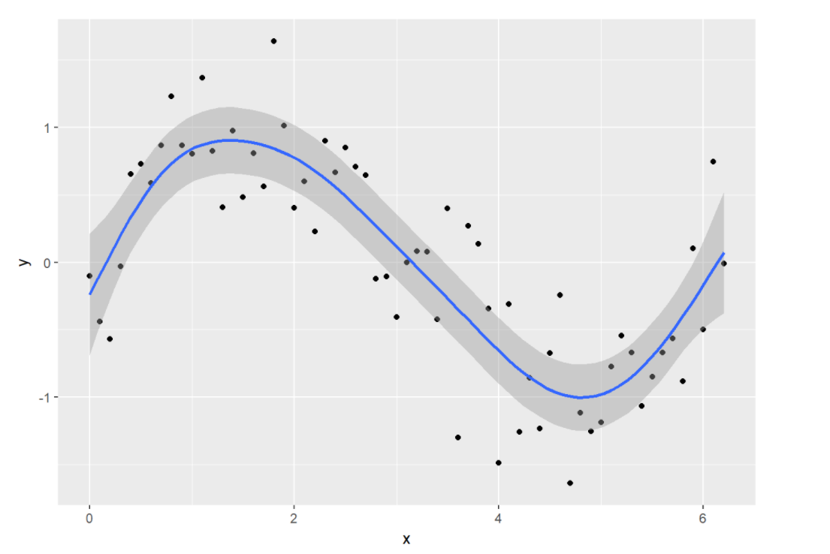
General Additive Model (GAM)

Slide 11
Geographically Weighted Regression (GWR)
Linear Regression
GWR
where W(i) - matrix of weights specific to location i s.t. observations nearer to i are given greater weights than observations further away.
- The weighting is determined by a distance-decay kernel function and a bandwidth parameter
criticized for artificially introducing multicollinearity between coefficient pairs (Wheeler and Tiefelsdorf 2005), which was recently refuted (Fotheringham and Oshan 2016)
penalized forms of GWR were proposed (e.g. geographically weighted lasso (Wheeler 2009), ridge (Wheeler 2009), ridge (Wheeler 2007, Bárcena et al. 2014), and elastic net regression (Li and Lam 2018))

Slide 12
Geographically Weighted ML
based on three base learners, which are an autoencoder-based deep residual network, XGBoost and random forest, and it incorporates spatial autocorrelation and heterogeneity to boost the ensemble predictions. Lianfa Li, Geographically Weighted Machine Learning and Downscaling for High Resolution Spatiotemporal Estimations of Wind Speed

Slide 13
Geographically Weighted ANN
Avariant of ANN that incorporates geographical weighting of connecting weights.
Principle idea:
Basic ANN with input, a hidden, and an output layer
Connecting weights of a basic ANN from the hidden to the output layer can be interpreted as the coefficients of a linear model of nonlinearly transformed variables (outputs of hidden neurons)
Connecting weights between the hidden and the output layer are estimated by utilizing a geographically weighted error function (weights can be interpreted as a GWR model).

Slide 14
Geographically Weighted ANN Architecture
GWANN is identical to the basic ANN, except that each output
neuron GWANN is assigned to a location in geographic space.
This allows to calculate the spatial distances between the
obserbations and the locations of the output neurons.
GWANN uses geographic weighted error function instead
of the basic quadratic error function in order ot calculate the signal
GWANN with three layers. The rectangle indicates that the output neurons are assigned to locations on a plane. Note that although each hidden neuron typically has connections to all output neurons, for the sake of clarity the outgoing connections are shown for a single hidden neuron only

Slide 15
Geographically Weigthed Deep Learning

Slide 16
Features/Predictors
Demographic and Environmental data
weekly reported dengue cases,
sea surface temperature,
precipitation,
air surface temperature,
humidity
population size (population risk and vulnerable population)
Remote sensing data
Aedes Mosquito monitoring (Too costly)
Number of tourists (Data not available)

Slide 17
Features/Predictors
Satellite Based Remote Sensing Environmental Data
Air temperature
Land Surface temperature
Rainfall
Humidity
Normalized difference vegetation index (ndvi)
Barangay Socioeconomic Data
Population density (Estimating the size of urban population using satellite images)
Road density (satellite images)
Land-use (satellite images)
GDP (Poverty estimation with satellite imagery)
Number of tourists (???)

Slide 18
Features/Predictors
Epidemiological Data
Patient ID
Age
Gender
Address
Date of onset
Virus Type
Table Detection and Text Exraction using OpenCV and Pytesseract

Slide 19
Research Status
Remote Sensing
Data Collection
Data Analysis
Statistics
Machine Learning
Deep Learning
Fastai
fast.ai is a non-profit research group focused on deep learning and artificial intelligence. It was founded in 2016 by Jeremy Howard and Rachel Thomas with the goal of democratising deep learning
QGIS
QGIS is a free and open-source cross-platform desktop geographic information system application that supports viewing, editing, and analysis of geospatial data

Slide 20
Thank you for your attention Remote Sensing is defined as the acquisition of information about an object without being in physical contact with it. Charles Elachi

