Slide 1
Summarization of scientific texts
S.A. Berezin
Novosibirsk State University
Notes:
Last year, BERT was released by researchers at Google, which proved to be one of the efficient and most effective algorithm changes since RankBrain. Looking at the initial results, BigBird is showing similar signs!

Slide 2
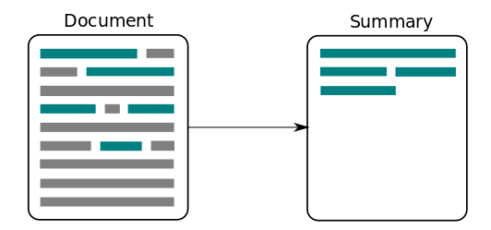
Text summarization using NER technologies
Question: How can we improve quality of text summarization and preserve all key entities in text?

Slide 3
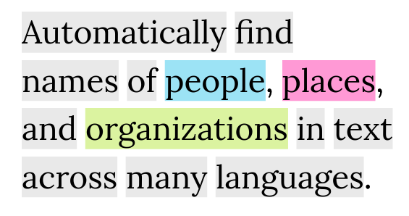
Task of named entity recognition
Find words and phrases related to certain categories: names, organizations, places, time, etc. .
Most of the existing solutions are created for texts of general subjects

Slide 4
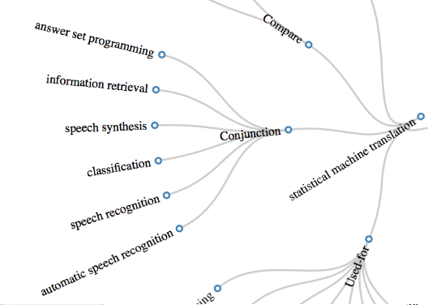
Data set SciERC
Annotations of 500 scientific articles
Entities of scientific topics: “task”, “method”, “material”, “evaluation metric” и др.

Slide 5
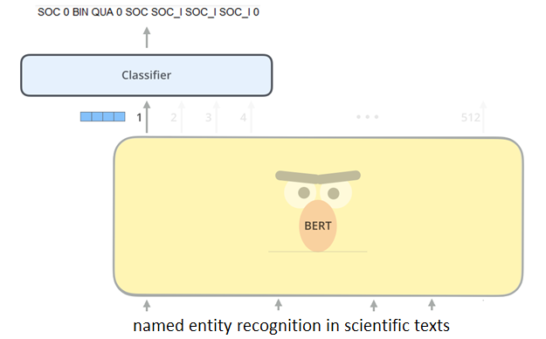
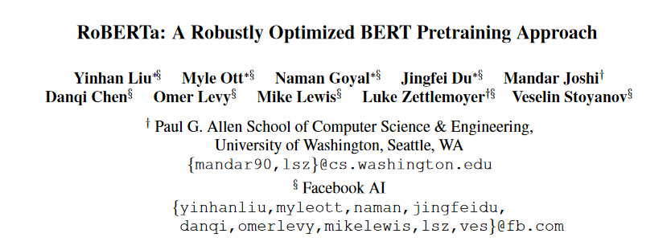
Approach 1: RoBERTa
Very high results on texts of general subject: Macro F1 = 0.97
Significantly harder solves the task of scientific texts: Macro F1 = 0.54

Slide 6
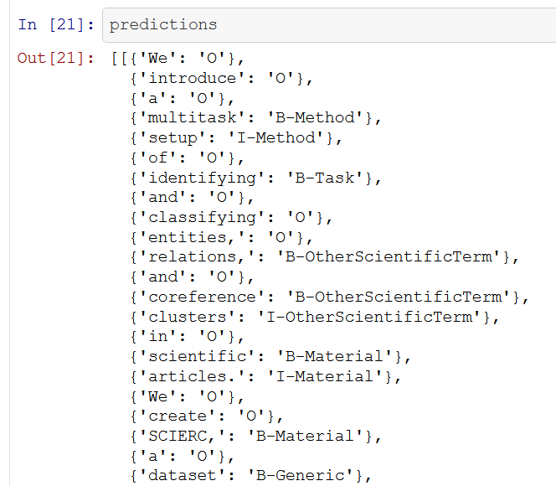
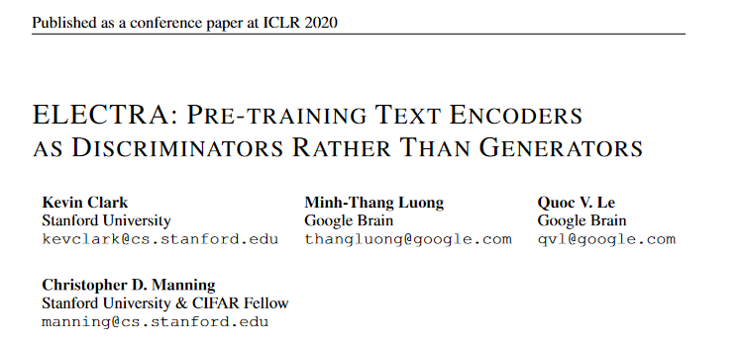
Approach 2: ELECTRA
Other approach to training of language model
The increase in the quality of the detection of named entities: Macro F1 = 0.58

Slide 7
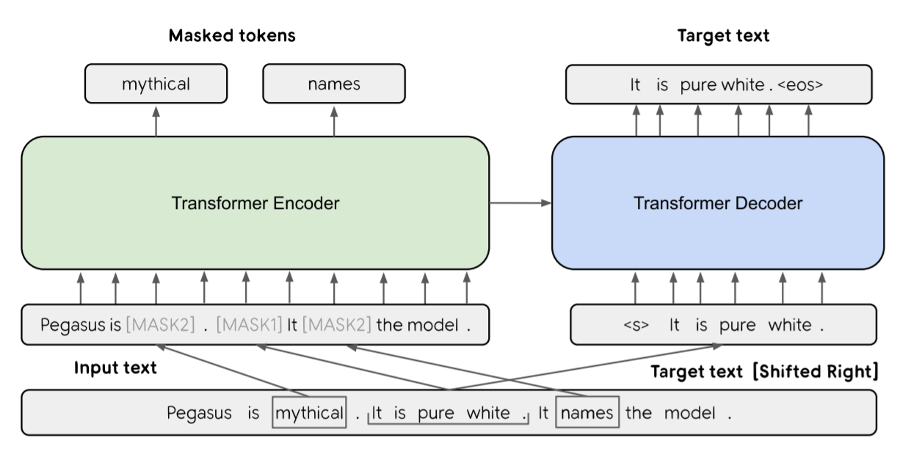
Summarization: PEGASUS

Slide 8
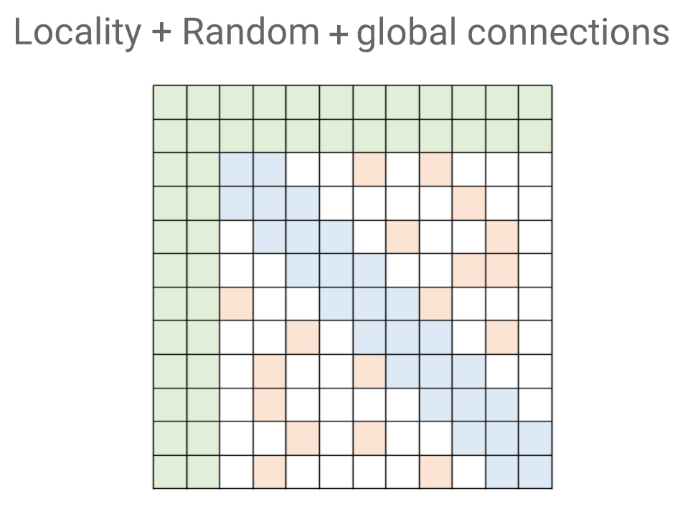
BigBird

Slide 9
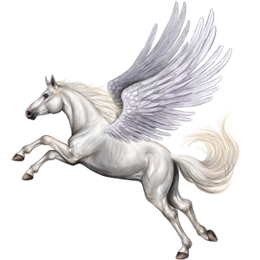
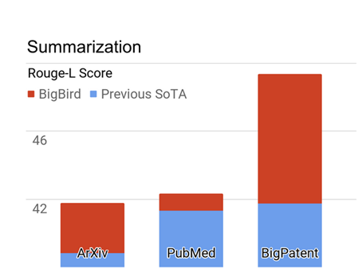
Text summarization using NER technologies
+
Hypothesis: Let’s find important entities with NER neural network and then train new SOTA PEGASUS + BigBird architecture!

Slide 10
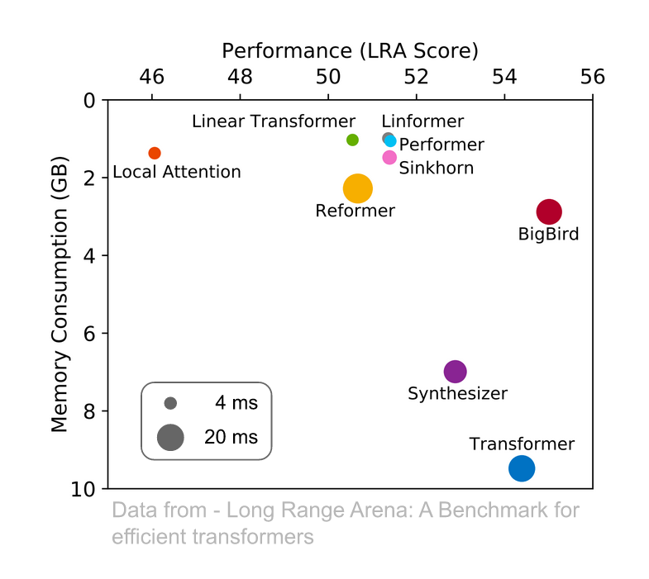
Key takeaways
Two different approaches to the extraction of named entities from scientific texts were tested
Work is underway to apply trained models to highlight information from scientific texts.
The hypothesis under study can improve the result achieved today in the task of the totalization of texts
Notes:
Right now, BigBird is encoder only so it doesn't generate text. Causal attention with the global memory is a bit weird, but we could probably do it.GPT-3 is only using a sequence length of 2048. In most of our paper, we use 4096, but we can go much larger 16k+. Of course, we don't nearly have as many parameters as GPT-3, so our generalization may not be as good.
BigBird is just an attention mechanism and could actually be complementary to GPT-3.

Slide 11
Thanks for your attention! [act] 0 [per] [act]
github.com/iis-research-team

