Slide 1
Application of segmentation algorithms to predict patient survival
M.A.Kochanov
Scientific adviser: B.N.Tuchinov
Novosibirsk State University

Slide 2
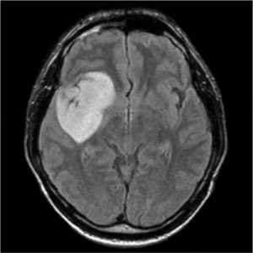
What do brain tumors look like on MRI?

Slide 3
Data preprocessing
yellow – peritumoral edema, blue – tumor, green - necrosis

Slide 4
Training dataset for segmentation
Total: $369$ patients, $57195$ images

Slide 5
Architectures to compare
U-Net
Ternaus-Net
DeepLabV3
Pix2Pix

Slide 6
How to compare?
Sørensen–Dice coefficient $=\frac{2|X∩Y|}{\left|X\right|+|Y|}$
$|X|$ and $|Y|$ – cardinality of two sets

Slide 7
U-Net
Basic solution for any segmentation problem

Slide 8
Ternaus-Net
Encoder U-Net ResNet18

Slide 9
DeepLabV3
Feature of architecture – usage of atrous convolutions

Slide 10
Pix2Pix
Conditional generative adversarial network. Heuristic for a problem of segmentation

Slide 11
Experiment. Finding the best loss function
$loss_{dice}$
$0.3 ∗loss_{bce}+0.7 ∗loss_{dice}$
$0.5 ∗loss_{bce}+0.5 ∗loss_{dice}$
$0.3 ∗loss_{bce}+0.2 ∗loss_{dice}+0.5 ∗loss_{focal}$
$$loss_{dice}=1 −dice$$
$$loss_{bce}=−ylog\left(p\right)−\left(1−y\right)\log\left(1−p\right)$$
$$loss_{focal}={\left(1−e^{\left(−loss_{bce}\right)}\right)}^{2}∗loss_{bce}$$

Slide 12
U-Net
Sørensen–Dice coefficient depending on the number of epochs
Loss functions depending on the number of epochs
The best loss function for U-Net: $0.3 ∗loss_{bce}+0.7 ∗loss_{dice}.$
With this loss U-Net get $dice=0.795.$

Slide 13
DeepLabV3
Sørensen–Dice coefficient depending on the number of epochs
Loss functions depending on the number of epochs
The best loss function for DeepLabV3: $0.5 ∗loss_{bce}+0.5 ∗loss_{dice}$.
With this loss DeepLabV3 get $dice=0.787.$

Slide 14
Ternaus-Net
Sørensen–Dice coefficient depending on the number of epochs
Loss functions depending on the number of epochs
The best loss function for Ternaus-Net: $0.3 ∗loss_{bce}+0.7 ∗loss_{dice}$.
With this loss Ternaus-Net get $dice=0.729.$

Slide 15
Results of the experiment. Choosing the best model
DeepLabV3
mask
Ternaus-Net
mask
MRI
Original mask
U-Net mask
Sørensen–Dice coefficient on validation
U-Net | DeepLabV3 | Ternaus-Net
0.795 | 0.787 | 0.729

Slide 16
Experiment. Finding the best augmentations
Affine transformations (vertical flip, horizontal flip, random rotation)
Soft transformations (vertical flip, horizontal flip, random rotation, random brightness, random contrast, random gamma)
Strong transformations (vertical flip, horizontal flip, random rotation, random brightness, random contrast, random gamma, shift, scale, elastic transform, grid distortion, optical distortion)

Slide 17
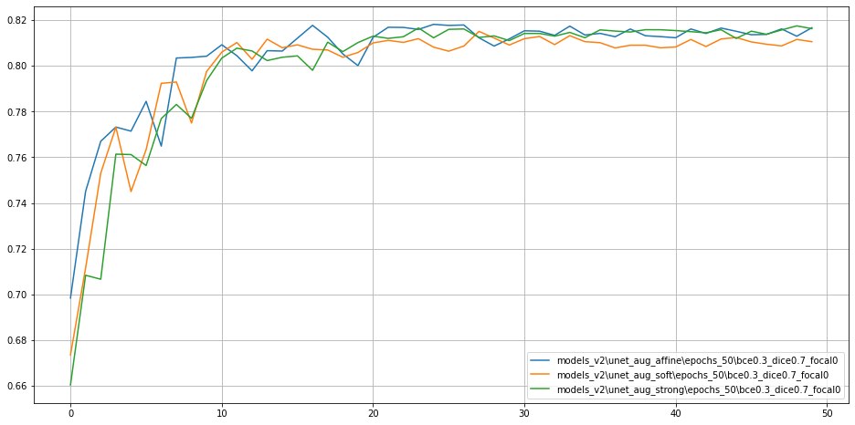
Result of the experiment
Sørensen–Dice coefficient depending on the number of epochs
green – strong, blue – affine, orange – soft
Best model – Unet with affine augmentations. $Dice score$of this model is $0.818$

Slide 18
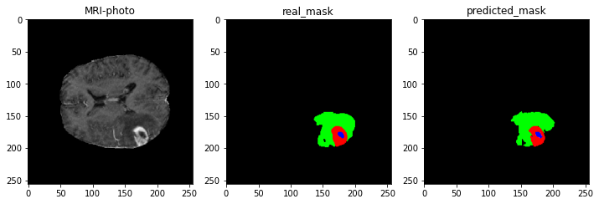
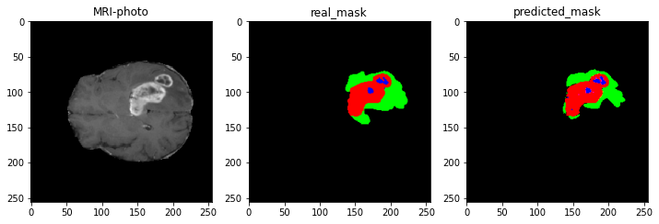

Slide 19
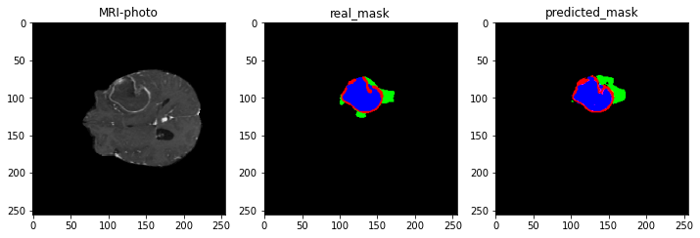
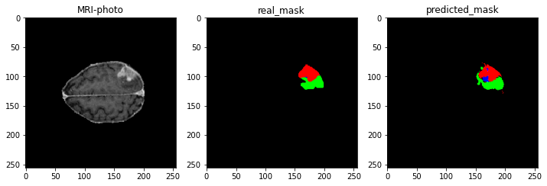

Slide 20
Survival prediction
Taken from https://arxiv.org/pdf/2101.01546.pdf

Slide 21
Feature extraction
Pyradiomics
Total: 236 rows, 323 columns

Slide 22
Further work
Show results for Pix2Pix
Feature selection
Choosing the best model for regression

